Slide 1
GUIDANCE: Teaching Excellence Action Plan (TEAP) and Teaching Excellence Monitoring Meeting (TEM) 2023/2024

Slide 2
Overview

Slide 3
What is a TEAP?
Teaching Excellence Action Plans (TEAPs) are a core mechanism, within our Quality Review and Enhancement Framework, supporting the continual evaluation and enhancement of teaching, learning and the student experience in all academic Departments. They are a means by which:
Departments commit to actions in response to both institutional and local priorities which have emerged from student feedback and other sources of evidence,
Departmental plans can be reviewed and supported, and
Implementation of actions can be monitored.
TEAPs are the primary means of articulating education-focused initiatives in each Department.
TEAPs have been designed to reflect the strategic importance of the Teaching Excellence Framework (TEF), and should be developed in context of the priorities for Education and Student Experience in the 2030 Strategy, and the priorities of the Education Strategy 2019-2025. The latter include:
Enhance our Undergraduate Offer in: the Quality of Learning, Teaching, Student Support and Student Outcomes; and in International Attractiveness
Create an Internationally-Recognised, Market-Led Postgraduate Taught Portfolio
Support and Enable Our People
Capitalise on Digital Transformation
Articulate a Distinctive Model for Education at Exeter

Slide 4
What is a TEM and how does this feed into our institutional priorities?
Department Teaching Excellence Action Plans undergo Faculty review and scrutiny via Teaching Excellence Monitoring (TEM) meetings.
Our institutional priorities are derived from the evaluation of a wide range of evidence. The National Student Survey (NSS) is particularly prominent as the primary source of feedback relating to undergraduate provision; the priorities align closely to areas identified for enhancement following analysis of the NSS results, as well as themes emerging from the previous year’s Teaching Excellence Monitoring cycle.
Our institutional priorities for 2023/2024 are as follows (mirroring 2022/2023). These should be utilised to help write TEAPs:
Success for All Our Students: Driving down experience and awarding gaps
Creating and strengthening learning communities: including partnership with student unions through academic representation) and freedom of expression (new NSS question 35. During your studies, how free did you feel to express your ideas, opinions, and beliefs?)
Using assessment and feedback to enhance learning and enable student success: with particular focus on how to realise efficiencies (reduce assessment burden) and design authentic assessment.
Providing consistent, robust personal academic support and guidance for every student.

Slide 5
Who is responsible for creating a TEAP?
Directors of Education and Student Experience in Departments should:
Lead the completion of the TEAP template, in consultation with colleagues and student representatives.
Collaborate with all relevant colleagues who can support in the development and implementation of TEAPs, including with all relevant Academic and Professional Service (PS) colleagues who can provide support, including Departmental Managers, and student representatives.
Identify actions/responsibilities to allocate to themselves and other staff.
Associate Pro-Vice Chancellors (Education) will oversee regular scrutiny of TEAPs in their Faculties, with Pro-Vice Chancellors having ultimate ownership of Faculty plans.

Slide 6
At what level is a TEAP created?
TEAPs should normally be written and implemented at the level of an academic Department, encompassing all taught students (UG and PGT).
In some cases, it may be appropriate to develop separate TEAPs at UG and PGT level, for specific programmes or groups of programmes at the discretion of the Directors of Education and Student Experience.
For Degree Apprenticeship programmes, the relevant Ofsted-stipulated Quality Improvement Plan (QIP – institutional level) and Self-Assessment Report (SAR – programme level) must be referenced in/appended to the appropriate TEAP. The information reported from the QIP or SAR does not necessitate duplication in the TEAP and may be dealt with through referencing the relevant documentation (e.g. ‘For Degree Apprenticeship-specific actions, please see the appended QIP/SAR’).
INTO should also be included in the TEAPs/TEMs processes, as well as programmes held in academic partnerships with other institutions.

Slide 7
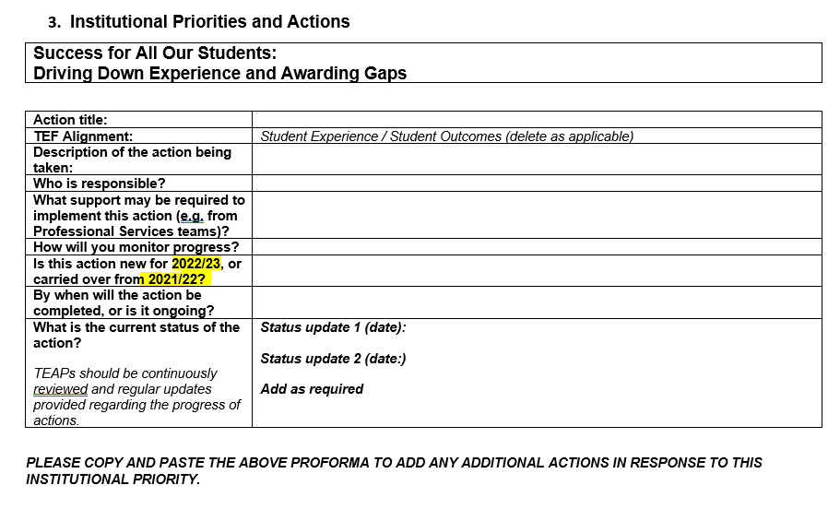
Where are the templates for TEAPs stored?
For 2023/24, Directors of Education and Student Experience do not need to create a new TEAP.
Instead, they should amend/update the TEAPs from 2022/23, but remove any references to the year (e.g. ‘2022/23’) to avoid the need to copy content across to new templates. E.g.,
Associate Pro Vice-Chancellors (Education) and the Director of Teaching Excellence and Enhancement will work with Directors of Education and Student Experience to ensure there is an opportunity to reflect on the recent 2023 TEM process and consider the next steps for the TEAPs as part of Faculty and Department Education and Student Experience meetings or as appropriate during Term 3 of 2022/23.
Note, this guidance refers to Term 1, 2 and 3 in accordance with https://www.exeter.ac.uk/about/facts/termdates/ ; Autumn (1), Spring (2) and Summer (3).

Slide 8
How should TEAPs be written?
The TEAP Template has two sections: Institutional Priorities and Actions, and Additional Local Priorities and Actions.
The template is also intended to demonstrate alignment to the structure of the TEF, to support preparation for TEF exercises.
Actions should be SMART (Specific, Measurable, Achievable (or Agreed), Realistic, Time-bound) fashion, with clear action owners and the identification of any support required.
Dates should be provided regarding updates on action statuses, to enable progress review.
All actions should have regard to differential experiences and outcomes within demographic groups within the student body.
There is no maximum number of actions to be included; urgency and importance should be balanced with capacity and practicability.
TEAPs should not be used to record ‘business-as-usual' or ‘standard operational’ actions; however, they should be considered as the primary record of Departmental/Programme-level strategic action planning regarding education and student experience.

Slide 9
How can I ensure my actions are SMART?
Specific – make a clear statement about what you are trying to achieve
Measurable – provide a target that can be measured (a numerical one is often beneficial)
Achievable – ensure the goal is realistic and attainable in the time allowed
Relevant – ensure the goal is linked to the strategic aims of the University and your Department
Time-bound – ensure the goal has a clearly defined timeframe

Slide 10
How often should TEAPs be reviewed?
Departments/Programmes and Faculties should continuously review and update their TEAPS to reflect progress against actions, and in response to new evidence, data, and feedback as it becomes available.
Associate Pro-Vice Chancellors (Education) will periodically update appropriate Boards/Committees on the development of their Faculties' TEAPS.
TEAPs should be developed and continuously reviewed in dialogue with student representatives, through Student-Staff Liaison Committees (SSLC) and other appropriate forums.
From 2023/24, a TEAP Action Tracking Template is available to Faculties to use to help track their actions across Departments. This is optional (see slide 17). Associate Pro-Vice Chancellors (Education) and Directors of Education and Student Experience should discuss how best to implement this.
Departments/Programmes and Faculties are encouraged to review and update their TEAP in Term 3 (including discussions with student representatives – see next slide) ahead of a new academic cycle, into better aid the use of these as "living documents".

Slide 11
How are students involved in creation of TEAPs?
Student representatives should be involved in every stage of the TEAP/TEM process.
This can be via SSLC or via other appropriate forums, including but not limited to, informal meetings and email.
It is important that the actions documented within TEAPs and/or Action Logs are shared, co-created and co-owned with SSLCs/appropriate forums and, through them, our student unions (the Students’ Guild in Exeter and Students’ Union in Cornwall). This can be by sharing the TEAP document, or by sharing a summary of the key actions. See later slides for information on optional Action Logs.
A handover period during Term 3, is encouraged, each academic year, whereby there is a chance for outgoing and incoming student representatives in partnership with the Directors of Education and Student Experience, to review SSLC activity and historic/ongoing priorities within the student experience across that Department.
The Directors of Education and Student Experience should then utilise the Term 3 handover period as a checkpoint to help review and update their TEAP for the upcoming cycle, allowing students to then further review and input into the TEAP in Term 1 of the new cycle.

Slide 12
Timeline

Slide 13
Process and timeline (use in Term 3 and summer 2022/23 ahead of the 2023/24 cycle)
When | Detail | Responsible | Notes
May 2023 | Release of TEAP / TEM guidance for 2023/24 | DVC E&SE, ELT, and QST | Departments review the previous TEAP, review completed and outstanding actions, and begin to create a TEAP for the 2023/24 cycle. This includes the actions carried over, and consideration of the institutional priorities outlined in previous slides. This should include creation of a plan to share these with students throughout the year (e.g., a copy of the TEAP or a summary of the key actions).
May-July 2023 | Re-development of the TEAP | Departments | Departments review the previous TEAP, review completed actions, review outstanding actions, and make changes to their TEAP for the current cycle. This includes the actions carried over, and consideration of the institutional priorities outlined in previous slides. This should include information on how this will be shared with students throughout the year. Departments should engage Students (e.g. via SSLC handover meetings, etc.) and staff (e.g. through Faculty Education and Student Experience Committees, Executive Committees, Faculty away days/TEM reflection meetings, Department away days/meetings, etc.) in the redevelopment of their TEAP.
14 July 2023 | Teaching Excellence Workshop (TEW) and writing retreat | DVC E&SE, ELT, and Departments | TEW is an opportunity for Departments to make changes to their TEAP following engagement activities with Students and staff across Term 3. See later slides for more information.
August 2023 | Anticipated release of NSS results | DVC, ELT, and BI Team | NSS data, comments and analysis are released to Departments, Faculties and institutional committees. ELT to update on any additions or amendments to institutional priorities in response to newly-arising evidence.
August-October 2023 | Revise and re-share TEAP for the Autumn Term | Departments | These revisions should signal progress in relation to actions, and any new actions identified in response to newly-arising evidence and institutional priorities.
Please note: APVCEs should ensure Quality and Standards have access to TEAPs and TEMs Minutes/Notes on an ongoing basis for monitoring and support purposes (liaise with educationpolicy@exeter.ac.uk).

Slide 14
Process and timeline (use in Term 1 for 2023/2024 onwards)
When | Detail | Responsible | Notes
By 30 September 2023 | Draft TEAPS to be shared with APVCEs for discussion at Faculty-level | Departments | Consultation with student representatives is strongly recommended as far as possible by this time, recognising that opportunities may be limited at this stage. Implementation of actions, and communication to students, should begin.
By 31 October 2023 | TEAPs have been consulted and signed off | APVCE | TEAPs or a summary of the key actions should be reviewed by students (e.g., via SSLCs), Faculty Education and Student Experience Committees, and Executives Committees (or equivalent). APVCEs will report on TEAPs periodically at relevant institutional committees. APVCEs can encourage Departments to record actions in the provided action log, to help enable tracking of actions (this is optional – see slide 17).
January 2024 | Revise and re-share TEAP for the Spring Term | Departments | Revisions to TEAPs should signal progress in relation to actions, and any new actions identified in response to newly-arising evidence/data.
March – May 2024 | TEMs | DVC E&SE as Chair DESEs presents And other members of Faculty also attend | TEMs provide an opportunity for review and discussion of the implementation of TEAPs, the sharing of good practice and challenges, and forward planning for the following academic year. Prior to TEM meetings, it is recommended that faculties should run Annual Review of Department meetings, reviewing the status of existing actions, monitoring the efficacy of completed actions, and agreeing new actions to be put in place for the following year. See QREF for more information.
May / June 2024 | Annual Review of Faculties | DVC E&SE and QST | Ahead of this, it is recommended Faculties run meetings to review outputs of the TEMs, the status of existing actions, monitoring of actions, etc. The Annual Review of Faculties will then determine the priorities for the following cycle. Best practice can also be shared.
Please note: APVCEs should ensure Quality and Standards have access to TEAPs and TEMs Minutes/Notes on an ongoing basis for monitoring and support purposes (liaise with educationpolicy@exeter.ac.uk).

Slide 15
Other important information

Slide 16
Teaching Excellence Workshop (TEW)
Each year, a TEW is held at the start of the cycle, intended to launch each taught Quality Review and Enhancement Cycle.
It also provides a "writing retreat" to support the development of TEAPs (including access to support from key Professional Services teams.
The next Teaching Excellence Workshop will take place on 14 July 2023.

Slide 17
Action Log: Monitoring actions and best practice
A template Action Log is available for Faculties to utilise to monitor Actions on an ongoing basis, across Departments, and across cycles.
This Action Log can also be distributed across Faculties to aid the sharing of best practice.
This is available here: https://as.exeter.ac.uk/academic-policy-standards/tqa-manual/qrf/annex-a/

Slide 18
Relevant Links
MI HUB: https://universityofexeteruk.sharepoint.com/sites/MIHub
Including NSS: https://universityofexeteruk.sharepoint.com/sites/MIHub/SitePages/NSS.aspx#nss-comments
TQA Manual: https://as.exeter.ac.uk/academic-policy-standards/tqa-manual/qrf/qualityreviewtaught/
Quality and Standards SharePoint site – including Action Log template, TEM notes, etc. https://universityofexeteruk.sharepoint.com/sites/QualityReviewandEnhancementFramework

Slide 19
Glossary
APVCE | Associate Pro-Vice Chancellor (Education)
DESE | Director of Education and Student Experience
DVC ESE | Deputy Vice-Chancellor (Education and Student Engagement)
ELT | Education Leadership Team
NSS | National Student Survey
PGT | Postgraduate Taught
QIP | Quality Improvement Plan
QST | Quality and Standards Team
SAR | Self-Assessment Report
SSLC | Student-Staff Liaison Committee
TEAP | Teaching Excellence Action Plan
TEF | Teaching Excellence Framework
TEM | Teaching Excellence Monitoring
TEW | Teaching Excellence Workshop
TQA | Teaching Quality Assurance Manual
UG | Undergraduate
QST | Quality and Standards Team

Slide 20
If you have any questions regarding this guidance or the QREF policy, please contact:
Educationpolicy@exeter.ac.uk

